Slide 3
Challenge from Last week.
Have you earnestly met Christ recently? Pick up a bible if not
Have you intentionally invited the socially unwelcomed recently? Who is that for you?

Slide 5
Luke 8: 1-3
After this, Jesus travelled about from one town and village to another, proclaiming the good news of the kingdom of God.
² The Twelve were with him, and also some women who had been cured of evil spirits and diseases: Mary (called Magdalene) from whom seven demons had come out; Joanna the wife of Chuza, the manager of Herod’s household; Susanna; and many others.
These women were helping to support them out of their own means.

Slide 6
John 19: 25-27
²⁵ Near the cross of Jesus stood his mother, his mother’s sister, Mary the wife of Clopas, and Mary Magdalene. ²⁶ When Jesus saw his mother there, and the disciple whom he loved standing nearby, he said to her, “Woman, here is your son,” ²⁷ and to the disciple, “Here is your mother.” From that time on, this disciple took her into his home.

Slide 7
John 20: 1-2, 11-18
Early on the first day of the week, while it was still dark, Mary Magdalene went to the tomb and saw that the stone had been removed from the entrance. ² So she came running to Simon Peter and the other disciple, the one Jesus loved, and said, “They have taken the Lord out of the tomb, and we don’t know where they have put him!”
¹¹ Now Mary stood outside the tomb crying. As she wept, she bent over to look into the tomb ¹² and saw two angels in white, seated where Jesus’ body had been, one at the head and the other at the foot.
¹³ They asked her, “Woman, why are you crying?”. “They have taken my Lord away,” she said, “and I don’t know where they have put him.” ¹⁴ At this, she turned around and saw Jesus standing there, but she did not realize that it was Jesus.

Slide 8
John 20: 1-2, 11-18
¹⁵ He asked her, “Woman, why are you crying? Who is it you are looking for?” Thinking he was the gardener, she said, “Sir, if you have carried him away, tell me where you have put him, and I will get him.”
¹⁶ Jesus said to her, “Mary.” She turned toward him and cried out in Aramaic, “Rabboni!” (which means “Teacher”). ¹⁷ Jesus said, “Do not hold on to me, for I have not yet ascended to the Father. Go instead to my brothers and tell them, ‘I am ascending to my Father and your Father, to my God and your God.’”
¹⁸ Mary Magdalene went to the disciples with the news: “I have seen the Lord!” And she told them that he had said these things to her.

Slide 9
What is a Christian?

Slide 10
What is a Christian?
A Christian is someone who believes in Jesus Christ and follows His teachings. The Bible says ‘If anyone is in Christ, there is a new creation. The old has gone, the new has come.’
In becoming a Christian, a person has changed the direction of their life. Instead of following their own desires and ambitions, they have said ‘sorry’ to God. As a result they have a relationship with God which will continue forever.
Through faith and out of God’s grace a Christian is saved from the penalty of Sin.

Slide 11
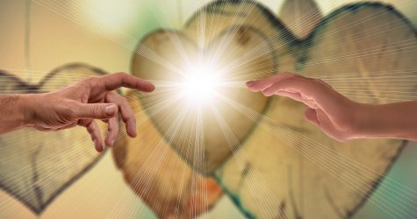
Devotion results from the natural outpouring of gratitude to God for His gift of Life to us

Slide 12
Out of love and gratitude, we express our devotion (dedication) to Him through three things: a passion to obey, a spirit of humility, and a servant’s heart.

Slide 13
Mary’s passion to Obey
Her obedience shown clearly by the immediacy in which she responded to Jesus’ request to tell the others.
Obedience here means far more than the act of following direction – doing what you are told

Slide 14
Mary’s passion to Obey – was out of love
C.S. Lewis said, “Obedience is the key that opens every door.”
But how do we obey without falling into legalism? Through love.
“If you love me, you will keep my commandments” (John 14:15).
Just as Jesus’ love for the Father was expressed in his obedience, so our love for Jesus is expressed in our obedience (15:9-10).

Slide 15
What and who do you obey?
Is your obedience to God done in love or because you feel that you must?

Slide 16
Mary’s spirit of Humility
The dictionary defines humility as modesty, lacking pretence, not believing that you are superior to others. An ancillary definition includes: "Having a lowly opinion of oneself, meekness".
Everything we read of Mary shows a spirit of humility: her respect to the gardener, her relationship with the disciples, ….

Slide 17
Mary’s spirit of Humility
“For whoever exalts himself will be humbled, and he who humbles himself will be exalted.” Luke 14:11.
“Therefore humble yourselves under the mighty hand of God, that He may exalt you in due time.” 1 Peter 5:6.

Slide 18
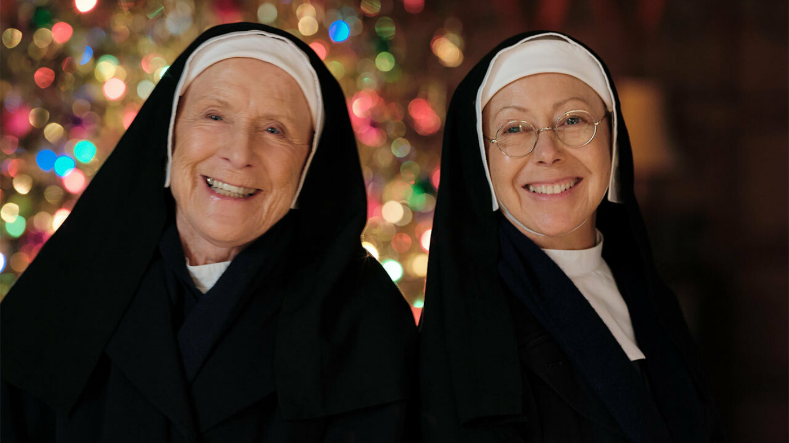

Slide 19
Mary’s Service heart
Mary served by giving financially and her time.
She was there before dawn on the day after Jesus’ burial
She stood at the tomb crying when “the disciples went back to their homes”.
She immediately did what Jesus asked of her in telling the “brothers” of his resurrection.
She was willing to find Jesus’ body and to return it.
………………

Slide 20
But what does it mean to Serve God?
Maybe the deepest and clearest answer is 1 Peter 4:11.
“Whoever serves, as one who serves by the strength that God supplies — in order that in everything God may be glorified through Jesus Christ. To him belong glory and dominion forever and ever.”
Every effort to serve of God, should be a God-given effort. Not effort for reward.

Slide 21
But what does it mean to Serve God?
Sturgeon describes Service to God in the following way.
Yes, serve God, but not by presuming to meet his need. He owns everything. He doesn’t need your supply. We call on him in need, not the other way around.

